Slide 1
12th Annual Carbon Report
40:20 Target
HCCAP Targets
 | Borough | Council
Target year | 2041 | 2027
Achieved reduction in CO₂ | 18% | 69%
Data year | 2015 to 2020 | 2014/15 to 2020/21
A total reduction of 43.1%
Source: LEGGI data for 2020 (2022)
Source: BEIS data for 2020 (2022)
Notes:
For the 40:20 Target, the Department for Business Energy and Industrial Strategy (BEIS) data is used, with a 2-year delay in reporting. This year we finally have the data to report against the target.
From 2019-2020 we achieved a 7.3% reduction in emissions according to the BEIS data.
We have met the 2020 target of a 40% reduction in emission and have gone beyond that with 43.1% reduction in total from the 2005 baseline. This has been supported by the decarbonisation of the national grid as well as the significant drop in transportation emission due to COVID-19 pandemic, which also means we might see an increase in emission for the year 2021 as the economy began recovered from the pandemic particularly in the transportation sector.
For the HCCAP targets, the London Energy and Greenhouse Gas Inventory (LEGGI) data is used, with 2-year delay in reporting.
Borough reduction
The overall reduction from 2015 to 2020 is 18%
The reduction for the last year of 2019 to 2020 was 6.1%
Council reduction
The overall reduction from the 2014/15 financial year to 2021/22 is 69%
The reduction for the last year of 2020/21 to 2021/22 is 17%
We are currently behind the target set in the Climate Change Action Plan to reach our net zero carbon goals.

Slide 2
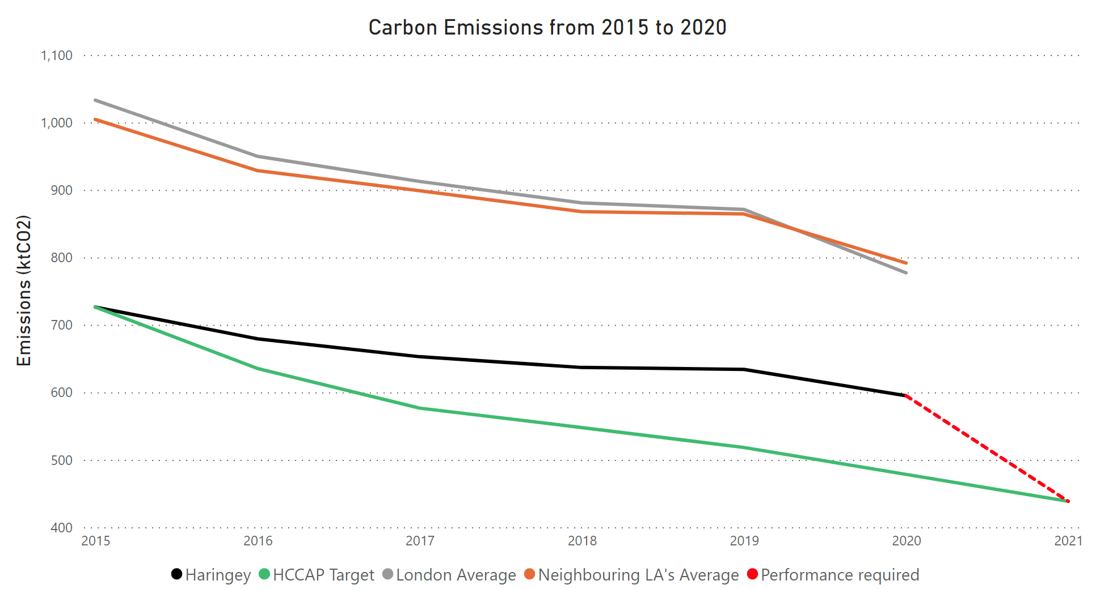
12th Annual Carbon Report
Source: LEGGI data 2015-2020; ARUP Analysis for the HCCAP
Notes:
The graph shows the 2005 to 2020 end-user CO₂ emissions trend in Haringey (black), compared to neighbouring boroughs’ mean (orange), and London mean (grey), and our HCCAP target (green).
Haringey’s emissions are consistently below the mean in neighbouring boroughs, but higher than the 2041 target trajectory.
We are currently behind the target set in the Climate Change Action Plan to reach our net zero carbon goals.
The red dashed line shows the performance required in 2020-2021 to return to our target trajectory.

Slide 3
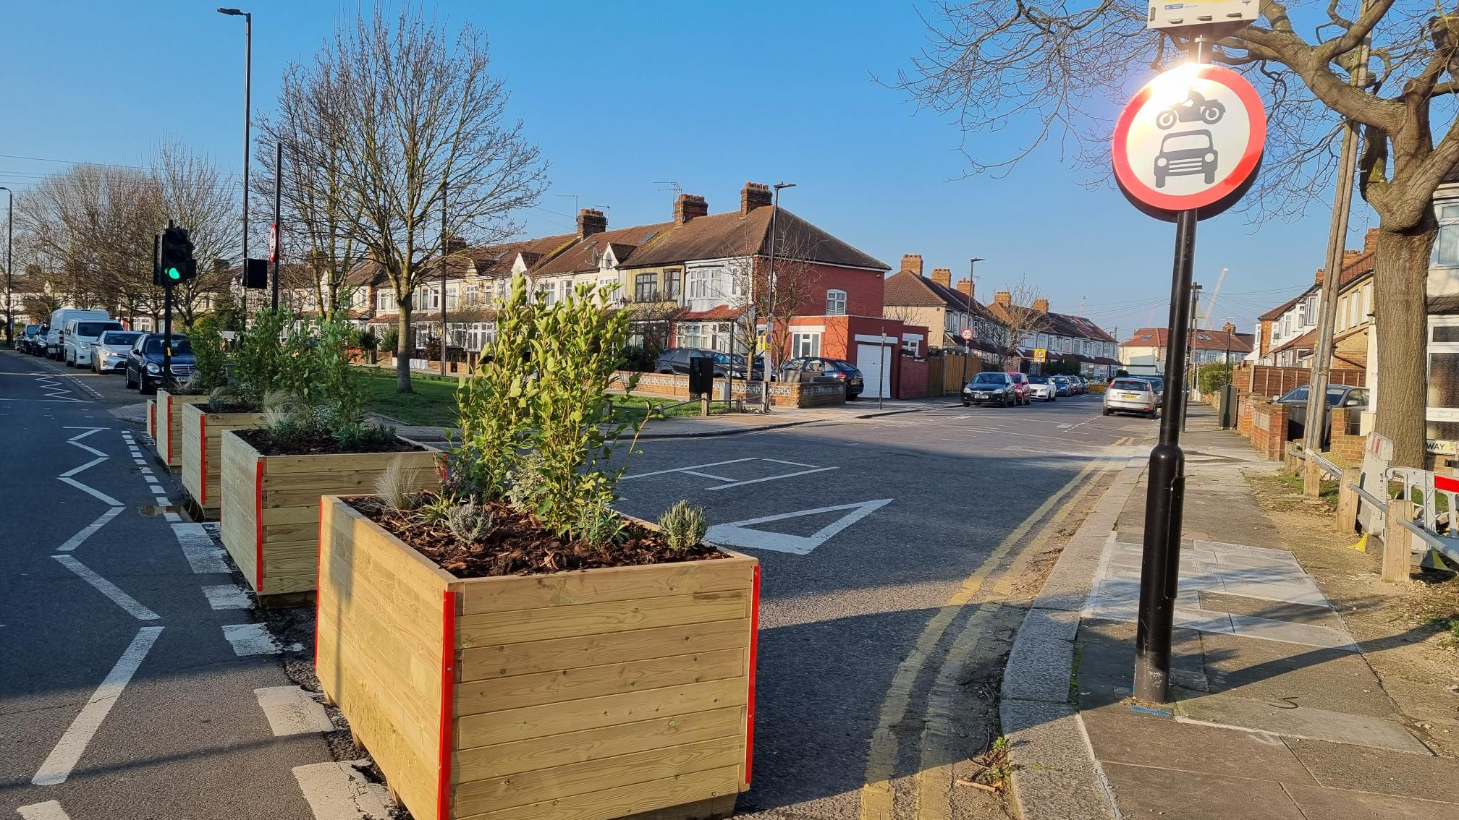
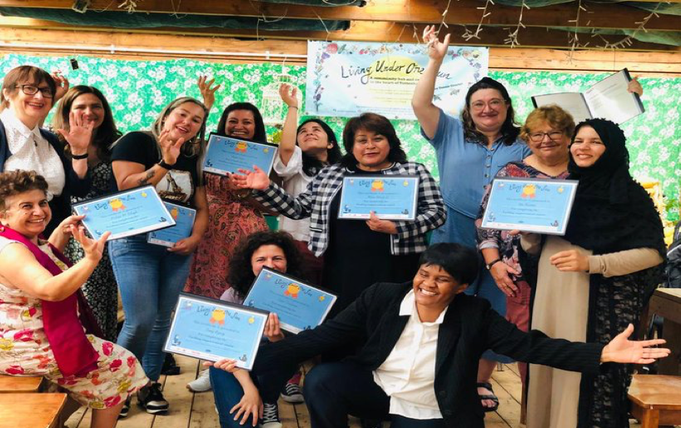
12th Annual Carbon Report
Projects Delivered in 2022
Council work:
Adoption of the Housing Energy Action Plan
Updates on the implementation of the £2.5m grant to support schools’ energy efficiency
Implementation of 23 new School Street Projects and introduction of 3 LTNs
Implementation of the Walking and Cycling Action Plan
Adoption of the Outline Business Case for the Decentralised Energy Networks
Delivery of the Year 1 Community Carbon Fund projects and opening of the Year 2 grant period.
Increasing the amount of the Council’s pension fund invested in low-carbon technologies and industries.
Community projects:
Green Open Homes by Muswell Hill Sustainability Group
Go Green Team at London Climate Action Week & Haringey’s Great Big Green Week
Belmont & The Vale School Street
Community Energy Champions training organised by LUOS
Notes:
In Jan 2023, the cabinet adopted the council’s Housing Energy Action Plan which sets out the council’s approach for retrofitting its housing stock, with detailed targets and outcomes for 5-year period from 2023 to 2028.
The council secured £2.45 million in grants to support refurbishment works on eight schools in the borough which should save an estimated of 226.8 tCO2e per year and also save the school an average of £9,000 per year.
We have successfully implemented 23 new school street projects.
The Walking and Cycling Action Plan (WCAP) sets out the council policy for our sustainable transport and active travel agenda. Within the Action Plan, 25 LTNs have been identified across Haringey.
Adoption of the Decentralised Energy Networks outline business case for Tottenham Hale and Wood Green.
The delivery of the Year 1 projects receiving grants from the Community Carbon Fund to which £90,000 was allocated; and opening of the Year 2 grant period to which £70,000 was allocated.
Increasing the amount of the Council’s pension fund invested in low carbon technologies and industries – 47.5% in low carbon indices 5% renewable energy infrastructure
Muswell Hill Sustainability Group organised a number of Green Open Homes which attracted 200 visitors to ten local homes and an expert talk session where a total audience of 100 joined to listen to the four expert speakers.
Go Green team ran a week of events for London Climate Action week in June/July and Great Big Green week in Sep/Oct.
CONTINUING PROJECTS (ONLY IF ASKED):
Continue to roll out the LED street lighting project.
We currently have another 13 School Streets projects in consultation and decision-making stages with implementation, subject to approval, planned this summer. Three of these projects are being delivered by the Planning and Regeneration Team by April 2023.
The council has made commitment to install around 100 EV charging points annually.
Produce Full Business Cases for the Wood Green and Tottenham Hale DENs in 2023. Begin work on site for the North Tottenham DEN in 2023.
Delivering the Year 2 CCF projects and opening of the Year 3 grant period.
Upgrade Park buildings to at least EPC grade E by 2023 and grade C by 2025.

Slide 4
12th Annual Carbon Report
Headline National & Regional Policies
International
COP27 in Egypt
COP 15 UN Biodiversity Conference in Montreal
IPCC Report: Climate Change 2022
National
CCC Progress Report
Building Regulations: Part F, L (updates), O & S (new)
London Plan – GLA Energy assessment guidance
ULEZ Expansion
Leading on impact study of new Building Regulations
Notes:
COP27 in Egypt
Handing over of COP residency from the UK to Egypt, and it also marked the 30th anniversary of UNFCCC.
Four key themes of the conference: Mitigation, adaptation, finance and collaboration.
Sharm el-Sheikh Implementation plan was published which reaffirms the commitment to limit the global temperature rise to 1.5°C above pre-industrial levels.
COP15: UN Biodiversity Conference in Montreal
A landmark agreement to protect 30% of the natural world by 2030.
The interim budget, the Cartagena Protocol on Biosafety, the Nagoya Protocol on Access and benefit were proposed.
The conference adopted the Kunming-Montreal Global Biodiversity Framework
IPCC report
IPCC working group III published Climate Change 2022: Mitigation of Climate change
It is the third contribution to the sixth assessment report.
The report warns that the world is set to reach 1.5°C level within the next two decades and only a drastic cut in carbon emission would help prevent an environmental disaster.
CCC Progress Report
The report was accompanied by a new Monitoring framework to tracking UK Net-Zero progress.
The report points out the rebound emission with 4% increase in 2021 as the economy began to recover from the COVID-19 pandemic.
call for urgent action towards delivery of tangible progress, actions to address the rising cost-of-living aligned with net-zero and rapid progress on wider enablers with public engagement strategy.
Building Regulations
Parts of Building regulation were updates for England and have taken effect from the 15th of June 2022.
Amendments were made to approved documents Part F, Part L, and the release of new document the Part O for new domestic buildings and Part S.
Part L sets out interim higher requirements for both new and existing building, in advance of consulting on the new Future Homes Standard anticipated to take effect from 2025
London Plan – Energy assessment guidance
Following the implementation of Part L 2021, GLA revised their guidance to enforce the London Plan SI2 requirement to achieve minimum 35% onsite carbon reduction. Residential developments are expected to be able to exceed this aiming for an additional benchmark exceeding 50% reduction over Part L2021.
It also introduces a new requirement to report on the Energy Use Intensity and space heating demand of development with recommended targets.
ULEZ Expansion
Following the expansion of ULEZ to the boundaries of North & South circular roads, a sixth month report was published showing significant reduction on the number of older, more polluting vehicles seen driving in London.
Plans are now underway to cover the whole of London within the M25.
Local Plan
The new Local Plan expected to be published for consultation in 2023, will include higher standards to tackler climate change, enhance sustainability and address climate change adaptation.
Following the 2020 Towards net zero carbon study, Haringey has commissioned an update to review the impact of the new Building Regs Part L2021 on the study findings, and associated planning policy recommendations and benchmarks.
The update will include predictive energy modelling results that rest and respond to new GLA energy assessment guidance.
Haringey is leading Towards Net Zero Carbon study in partnership with 18 other London Boroughs.

Slide 5
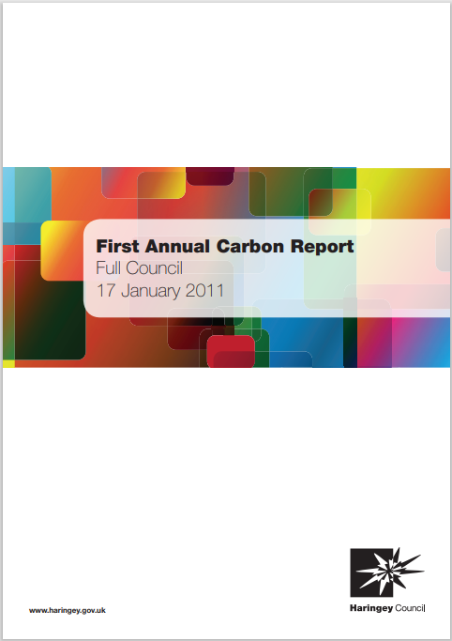
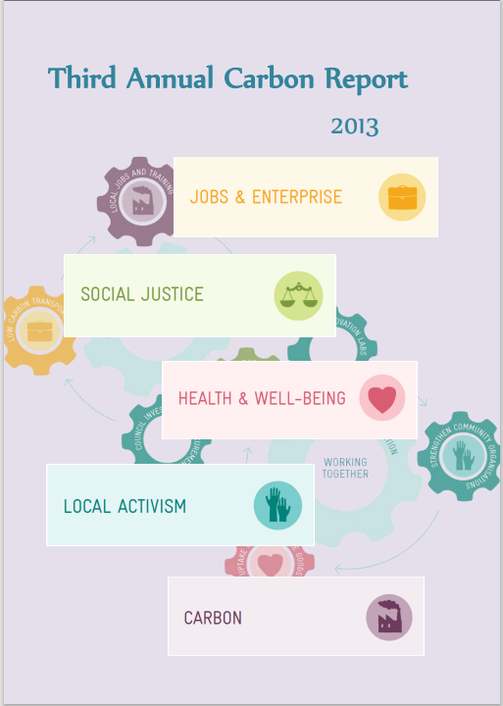
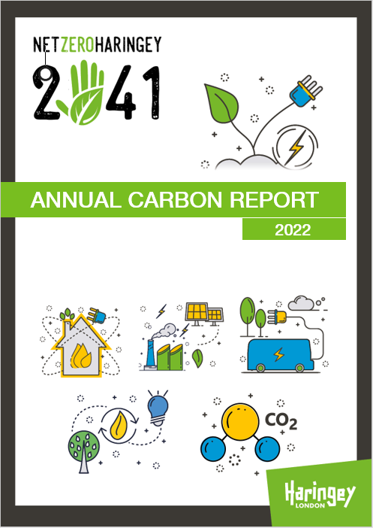
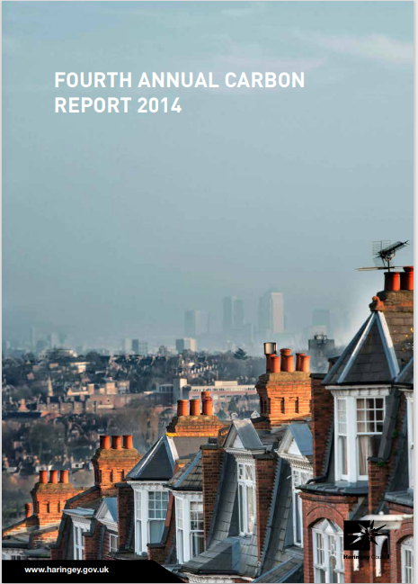
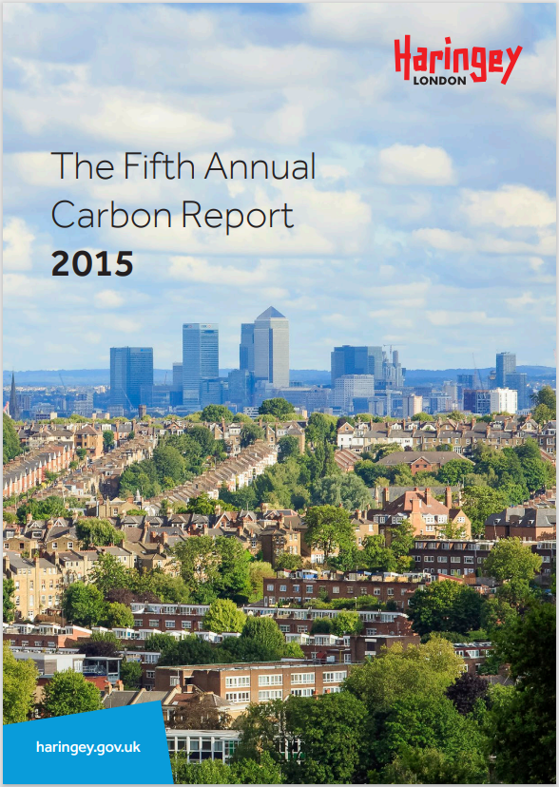
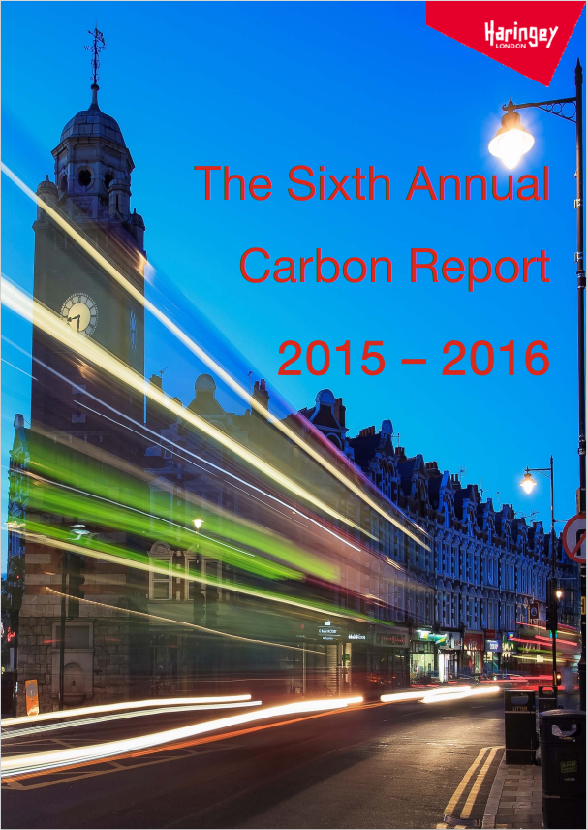
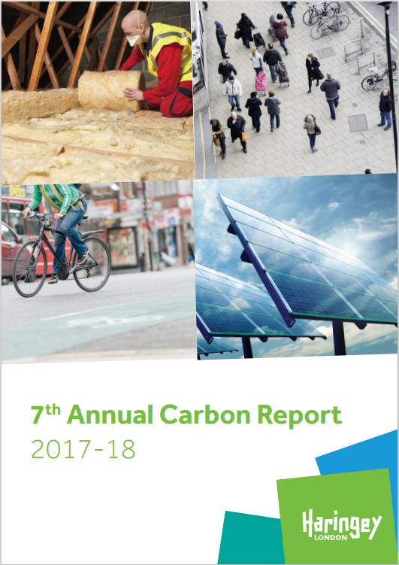
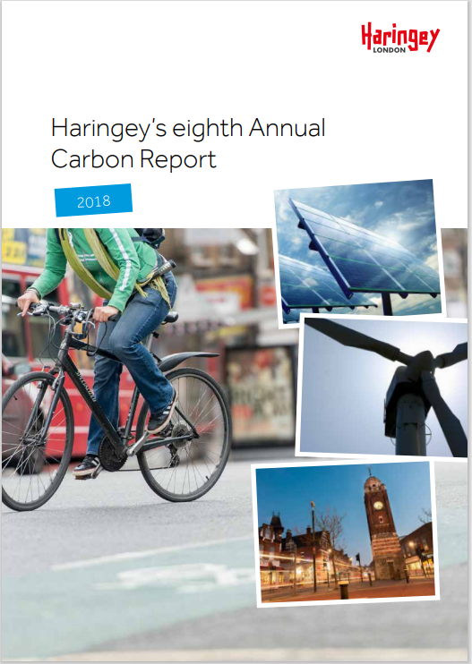
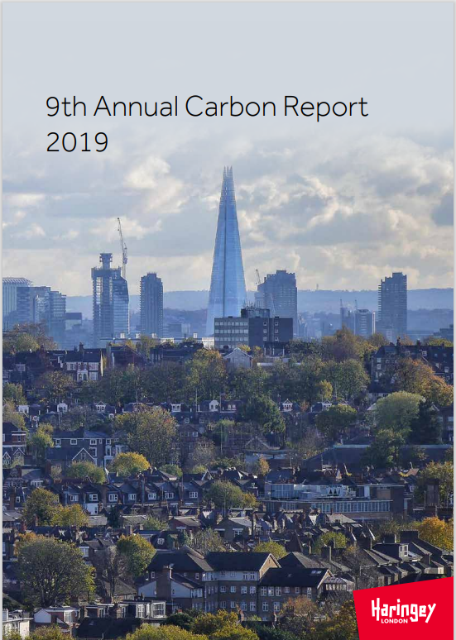
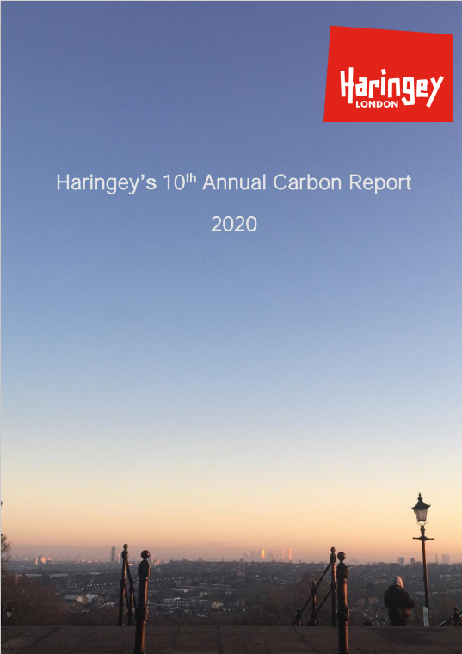
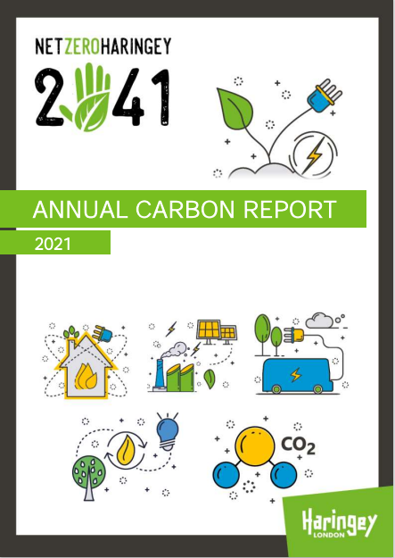
12th Annual Carbon Report
Background to the Twelfth Annual Carbon Report
Second Annual Carbon Report since adopting the Haringey Climate Change Action Plan (HCCAP) in March 2021.
Reports on:
Completion of 40:20 emissions target
Progress towards HCCAP target of being a Net Zero Carbon Borough by 2041
Reports on relevant carbon reduction projects delivered across the borough in 2022.
Notes:
This report follows the last year’s structure that reflects the six areas laid out in the HCCAP – council, housing, workplace, transport, energy, community.
This is the second annual carbon report since the adoption of Haringey Climate Change Action Plan in March 2021.
It reports on our progress towards the
40:20 ambition that was agreed in 2012 and set out an emission target of a 40% reduction in emission by 2020 from a 2005 baseline.
It also reports on the HCCAP target of being a Net Zero Carbon Borough by 2041.
This reports all relevant carbon reduction projects delivered across the borough this year.

